Slide 1
Chapter 6
The Relational Algebra

Slide 2
Relational Algebra
Relational algebra is the basic set of operations for the relational model
These operations enable a user to specify basic retrieval requests (or queries)

Slide 3
Relational Algebra Overview
Relational Algebra consists of several groups of operations
  Unary Relational Operations
    SELECT (symbol: σ (sigma))
    PROJECT (symbol: π (pi))
    RENAME (symbol: ρ (rho))
  Relational Algebra Operations From Set Theory
    UNION ( ∪ ), INTERSECTION ( ∩ ), DIFFERENCE (or MINUS, – )
    CARTESIAN PRODUCT ( x )
  Binary Relational Operations
    JOIN (several variations of JOIN exist)
    DIVISION
  Additional Relational Operations
    OUTER JOINS, OUTER UNION
    AGGREGATE FUNCTIONS

Slide 4
Unary Relational Operations
    SELECT (symbol: σ (sigma))
    PROJECT (symbol: π (pi))
    RENAME (symbol: ρ (rho))

Slide 5

Database State for COMPANY
All examples discussed below refer to the COMPANY database shown here.

Slide 6
SELECT
The SELECT operation (denoted by σ (sigma)) is used to select a subset of the tuples from a relation based on a selection condition
  The selection condition acts as a filter
  Keeps only those tuples that satisfy the qualifying condition
  Tuples satisfying the condition are selected whereas the other tuples are discarded (filtered out)

Slide 7
SELECT
Examples:
  Select the EMPLOYEE tuples whose department number is 4:
σ _{DNO = 4} (EMPLOYEE)
  Select the employee tuples whose salary is greater than $30,000:
σ _{SALARY > 30,000} (EMPLOYEE)

Slide 8
SELECT
  In general, the select operation is denoted by σ _{<selection condition>}(R) where
    the symbol σ (sigma) is used to denote the select operator
    the selection condition is a Boolean (conditional) expression specified on the attributes of relation R
    tuples that make the condition true are selected
      (appear in the result of the operation)
    tuples that make the condition false are filtered out
      (discarded from the result of the operation)

Slide 9
SELECT
The Boolean expression specified in <selection condition> is made up of a number of clauses of the form:
<attribute name> <comparison op> <constant value>
or
<attribute name> <comparison op> <attribute name>
Where <attribute name> is the name of an attribute of R, <comparison op> id normally one of the operations {=,>,>=,<,<=,!=}
Clauses can be arbitrarily connected by the Boolean operators and, or and not

Slide 10
SELECT
For example, to select the tuples for all employees who either work in department 4 and make over $25000 per year, or work in department 5 and make over $30000, the select operation should be:
σ (DNO=4 AND Salary>25000 ) OR (DNO=5 AND Salary>30000 ) (EMPLOYEE)

Slide 11

The following query results refer to this database state

Slide 12
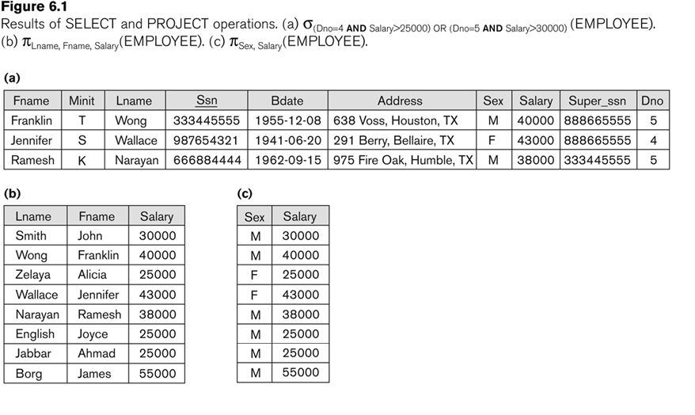
Examples of applying SELECT and PROJECT operations

Slide 13
SELECT (contd.)
SELECT Operation Properties
  SELECT σ is commutative:
    σ _{<condition1>}(σ _{< condition2>} (R)) = σ _{<condition2>} (σ _{< condition1>} (R))
  A cascade of SELECT operations may be replaced by a single selection with a conjunction of all the conditions:
  σ_{<cond1>}(σ_{< cond2>} (σ_{<cond3>}(R)) = σ <cond1> AND < cond2> AND < cond3>(R)

Slide 14
PROJECT
PROJECT Operation is denoted by π (pi)
If we are interested in only certain attributes of relation, we use PROJECT
This operation keeps certain columns (attributes) from a relation and discards the other columns.

Slide 15
PROJECT
  PROJECT creates a vertical partitioning
    The list of specified columns (attributes) is kept in each tuple
    The other attributes in each tuple are discarded

Slide 16
PROJECT
Example: To list each employee’s first and last name and salary, the following is used:
  π_{LNAME, FNAME,SALARY}(EMPLOYEE)

Slide 17
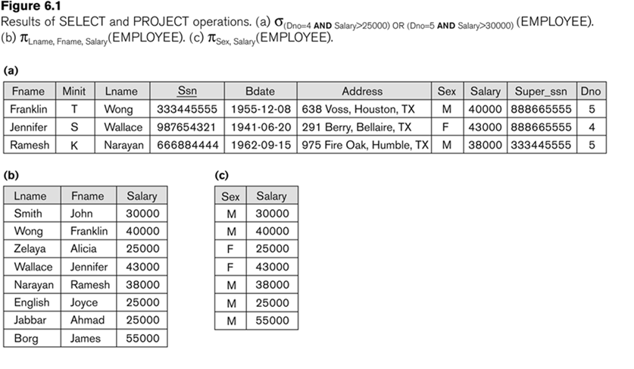
Examples of applying SELECT and PROJECT operations

Slide 18
Duplicate elimination
If the attribute list includes only non-key attributes, duplicate tuples are likely to occur
The PROJECT operation removes any duplicate tuples
Example: (c) in figure 6.1

Slide 19
Single expression versus sequence of relational operations
We may want to apply several relational algebra operations one after the other
  Either we can write the operations as a single relational algebra expression by nesting the operations, or
  We can apply one operation at a time and create intermediate result relations.
  In the latter case, we must give names to the relations that hold the intermediate results.

Slide 20
Single expression versus sequence of relational operations
To retrieve the first name, last name, and salary of all employees who work in department number 5, we must apply a select and a project operation
We can write a single relational algebra expression as follows:
  π_{FNAME, LNAME, SALARY}(σ _{DNO=5}(EMPLOYEE))
OR We can explicitly show the sequence of operations, giving a name to each intermediate relation:
  DEP5_EMPS ← σ _{DNO=5}(EMPLOYEE)
  RESULT ← π _{FNAME, LNAME, SALARY} (DEP5_EMPS)

Slide 21
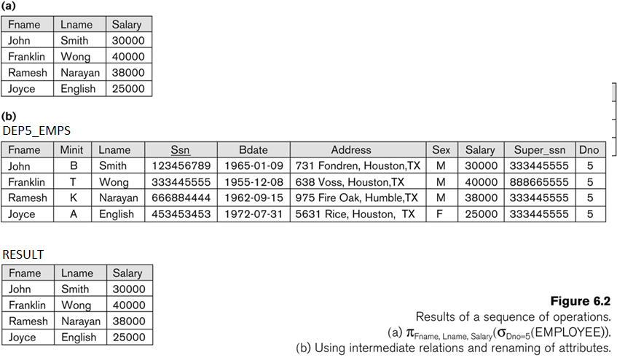
Example of applying multiple operations and RENAME

Slide 22
RENAME
The RENAME operator is denoted by ρ (rho)
In some cases, we may want to rename the attributes of a relation or the relation name or both
  Useful when a query requires multiple operations
  Necessary in some cases (see JOIN operation later)

Slide 23
RENAME
RENAME operation – which can rename either the relation name or the attribute names, or both

Slide 24
RENAME
The general RENAME operation ρ can be expressed by any of the following forms:
  ρ_{S}(R) changes:
    the relation name only to S
  ρ_{(B1, B2, …, Bn )}(R) changes:
    the column (attribute) names only to B1, B1, …..Bn
  ρ_{S (B1, B2, …, Bn )}(R) changes both:
    the relation name to S, and
    the column (attribute) names to B1, B1, …..Bn

Slide 25
Relational Algebra Operations from Set Theory
Union
Intersection
Minus
Cartesian Product

Slide 26
UNION
It is a Binary operation, denoted by ∪
  The result of R ∪ S, is a relation that includes all tuples that are either in R or in S or in both R and S
  Duplicate tuples are eliminated

Slide 27
UNION
  The two operand relations R and S must be “type compatible” (or UNION compatible)
    R and S must have same number of attributes
    Each pair of corresponding attributes must be type compatible (have same or compatible domains)

Slide 28
UNION
Example:
  To retrieve the social security numbers of all employees who either work in department 5 (RESULT1 below) or directly supervise an employee who works in department 5 (RESULT2 below)

Slide 29
UNION
DEP5_EMPS ← σ_{DNO=5} (EMPLOYEE)
RESULT1 ← π _{SSN}(DEP5_EMPS)
RESULT2 ← π_{SUPERSSN}(DEP5_EMPS)
RESULT ← RESULT1 ∪ RESULT2
The union operation produces the tuples that are in either RESULT1 or RESULT2 or both

Slide 30
The following query results refer to this database state

Slide 31
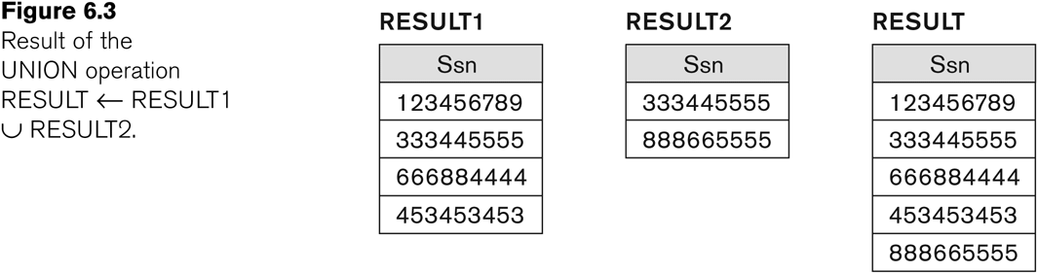
Example of the result of a UNION operation
UNION Example

Slide 32
INTERSECTION
INTERSECTION is denoted by ∩
The result of the operation R ∩ S, is a relation that includes all tuples that are in both R and S
  The attribute names in the result will be the same as the attribute names in R
The two operand relations R and S must be “type compatible”

Slide 33
SET DIFFERENCE
SET DIFFERENCE (also called MINUS or EXCEPT) is denoted by –
The result of R – S, is a relation that includes all tuples that are in R but not in S
  The attribute names in the result will be the same as the attribute names in R
The two operand relations R and S must be “type compatible”

Slide 34
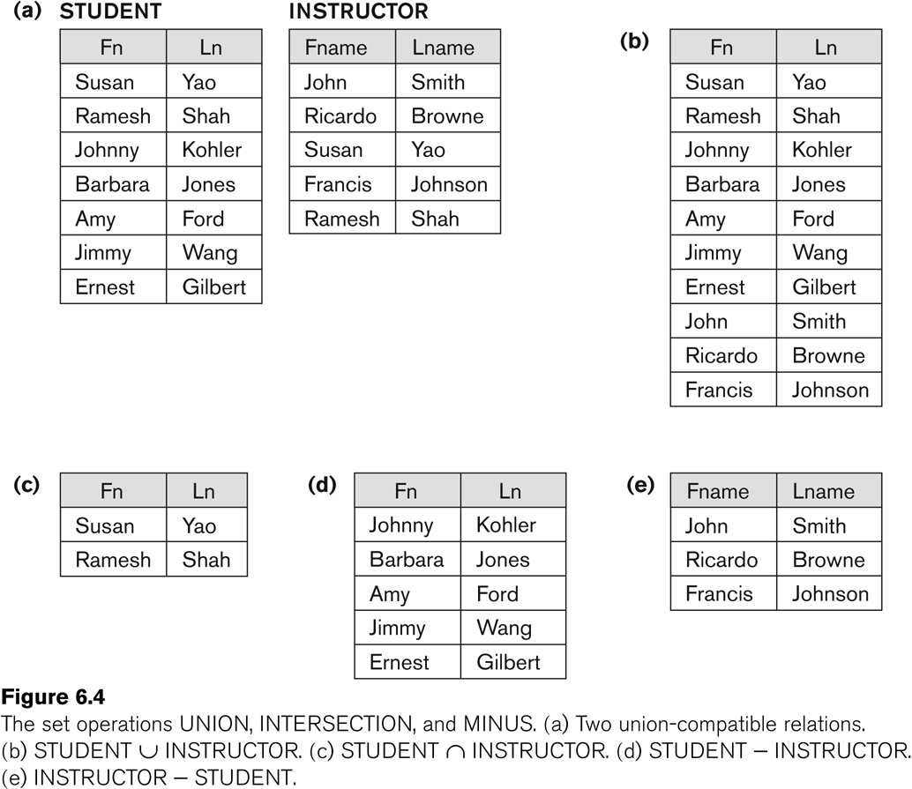
Example to illustrate the result of UNION, INTERSECT, and DIFFERENCE

Slide 35
Some properties of UNION, INTERSECT, and DIFFERENCE
Notice that both union and intersection are commutative operations; that is
  R ∪ S = S ∪ R, and R ∩ S = S ∩ R
Both union and intersection can be treated as n-ary operations applicable to any number of relations as both are associative operations; that is
  R ∪ (S ∪ T) = (R ∪ S) ∪ T
  (R ∩ S) ∩ T = R ∩ (S ∩ T)
The minus operation is not commutative; that is, in general
  R – S ≠ S – R

Slide 36
CARTESIAN PRODUCT
CARTESIAN PRODUCT Operation
  This operation is used to combine tuples from two relations in a combinatorial fashion.
  Denoted by R(A1, A2, . . ., An) x S(B1, B2, . . ., Bm)
  Result is a relation Q with degree n + m attributes:
    Q(A1, A2, . . ., An, B1, B2, . . ., Bm), in that order.

Slide 37
CARTESIAN PRODUCT
  The resulting relation state has one tuple for each combination of tuples—one from R and one from S.
  Hence, if R has n_{R} tuples (denoted as |R| = n_{R} ), and S has n_{S} tuples, then R x S will have n_{R} * n_{S} tuples.
  The two operands do NOT have to be "type compatible”

Slide 38
CARTESIAN PRODUCT
Generally, CROSS PRODUCT is not a meaningful operation
  Can become meaningful when followed by other operations
Example (not meaningful):
  FEMALE_EMPS ← σ _{SEX=’F’}(EMPLOYEE)
  EMPNAMES ← π _{FNAME, LNAME, SSN} (FEMALE_EMPS)
  EMP_DEPENDENTS ← EMPNAMES x DEPENDENT

Slide 39
The following query results refer to this database state

Slide 40
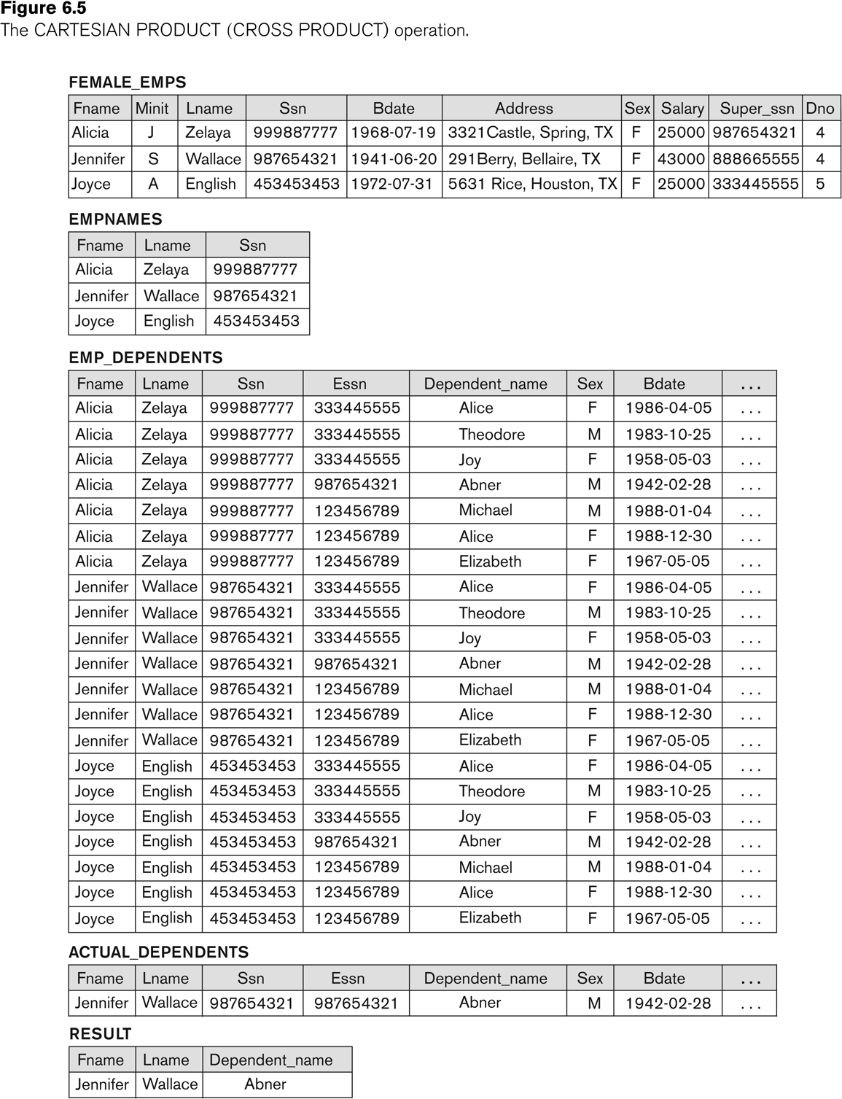
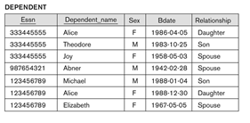
Example of applying CARTESIAN PRODUCT

Slide 41
Example of applying CARTESIAN PRODUCT
To keep only combinations where the DEPENDENT is related to the EMPLOYEE, we add a SELECT operation as follows
Add:
  ACTUAL_DEPS ← σ _{SSN=ESSN}(EMP_DEPENDENTS)
  RESULT ← π _{FNAME, LNAME, DEPENDENT_NAME} (ACTUAL_DEPS)

Slide 42
Binary Relational Operations
Join
Division

Slide 43
JOIN
JOIN Operation (denoted by )
  The sequence of CARTESIAN PRODECT followed by SELECT is used quite commonly to identify and select related tuples from two relations
  This operation is very important for any relational database with more than a single relation, because it allows us combine related tuples from various relations

Slide 44
JOIN
  The general form of a join operation on two relations R(A1, A2, . . ., An) and S(B1, B2, . . ., Bm) is:
  R _{<join condition>}S
  where R and S can be any relations that result from general relational algebra expressions.

Slide 45
JOIN
Example: Suppose that we want to retrieve the name of the manager of each department.
To get the manager’s name, we need to combine each DEPARTMENT tuple with the EMPLOYEE tuple whose SSN value matches the MGRSSN value in the department tuple.
DEPT_MGR ← DEPARTMENT _{MGRSSN=SSN} EMPLOYEE

Slide 46
The following query results refer to this database state

Slide 47
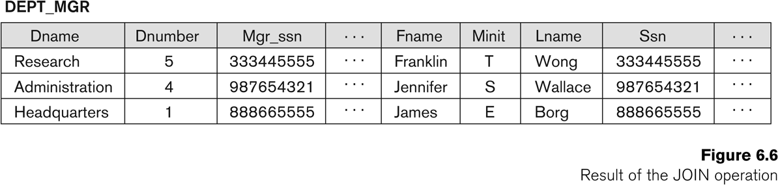
Example of applying the JOIN operation
DEPT_MGR ← DEPARTMENT _{MGRSSN=SSN} EMPLOYEE

Slide 48
JOIN
Consider the following JOIN operation:
  If R(A1, A2, . . ., An) and S(B1, B2, . . ., Bm)
    Think about R.Ai=S.Bj
  Result is a relation Q with degree n + m attributes:
    Q(A1, A2, . . ., An, B1, B2, . . ., Bm), in that order.
  The resulting relation state has one tuple for each combination of tuples—r from R and s from S, but only if they satisfy the join condition r[Ai]=s[Bj]
  Hence, if R has n_{R} tuples, and S has n_{S} tuples, then the join result will generally have less than n_{R} * n_{S} tuples.

Slide 49
JOIN
The general case of JOIN operation is called a Theta-join: R theta S
The join condition is called theta
Theta can be any general boolean expression on the attributes of R and S; for example:
  R.Ai<S.Bj AND (R.Ak=S.Bl OR R.Ap<S.Bq)

Slide 50
EQUIJOIN
The most common use of join involves join conditions with equality comparisons only
Such a join, where the only comparison operator used is =, is called an EQUIJOIN
The JOIN seen in the previous example was an EQUIJOIN

Slide 51
NATURAL JOIN
Another variation of JOIN called NATURAL JOIN — denoted by *
  It was created to get rid of the second (superfluous) attribute in an EQUIJOIN condition.

Slide 52
NATURAL JOIN
Another example: Q ← R(A,B,C,D) * S(C,D,E)
  The implicit join condition includes each pair of attributes with the same name, “AND”ed together:
    R.C=S.C AND R.D = S.D
  Result keeps only one attribute of each such pair:
    Q(A,B,C,D,E)

Slide 53
NATURAL JOIN
Example: To apply a natural join on the DNUMBER attributes of DEPARTMENT and DEPT_LOCATIONS, it is sufficient to write:
  DEPT_LOCS ← DEPARTMENT * DEPT_LOCATIONS
Only attribute with the same name is DNUMBER
An implicit join condition is created based on this attribute:
  DEPARTMENT.DNUMBER=DEPT_LOCATIONS.DNUMBER

Slide 54
The following query results refer to this database state

Slide 55
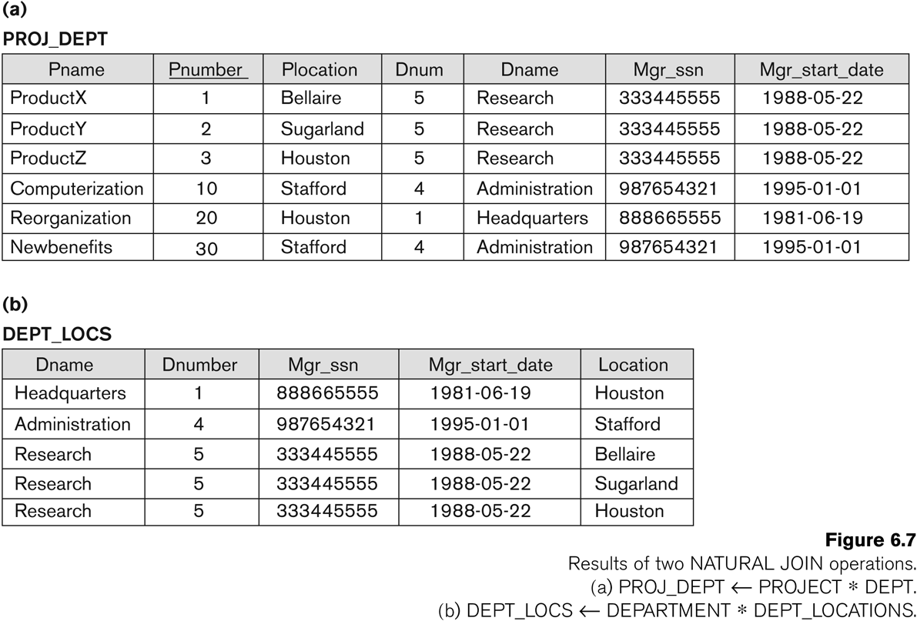
Example of NATURAL JOIN operation

Slide 56
Complete Set of Relational Operations
The set of operations including SELECT σ, PROJECT π , UNION ∪, DIFFERENCE − , RENAME ρ, and CARTESIAN PRODUCT X is called a complete set because any other relational algebra expression can be expressed by a combination of these five operations.
For example:
  R ∩ S = (R ∪ S ) – ((R − S) ∪ (S − R))
  R _{<join condition>}S = σ _{<join condition>} (R X S)

Slide 57
Examples of Queries in Relational Algebra
Q1: Retrieve the name and address of all employees who work for the ‘Research’ department.

Slide 58
The following query results refer to this database state

Slide 59
Examples of Queries in Relational Algebra
Q2: For every project located in “Stafford”, list the project number, the controlling department number, and the department manager’s last name, address, and Bdate

Slide 60
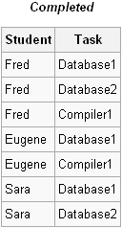


Relational Algebra
Divide Operator
  Divide Operator returns every tuple from R that match all tuples in S; R and S must be division compatible
  R ÷ S
  Let R be COMPLETED and S be DBPROJECT we can get the result as

Slide 61
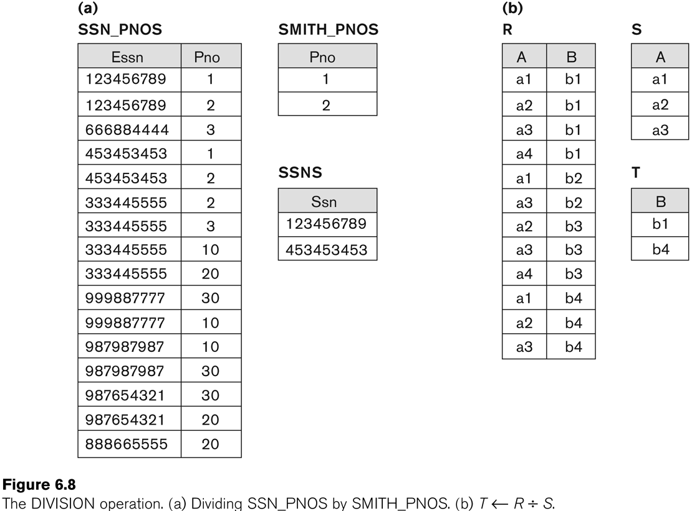
Example of DIVISION

Slide 62
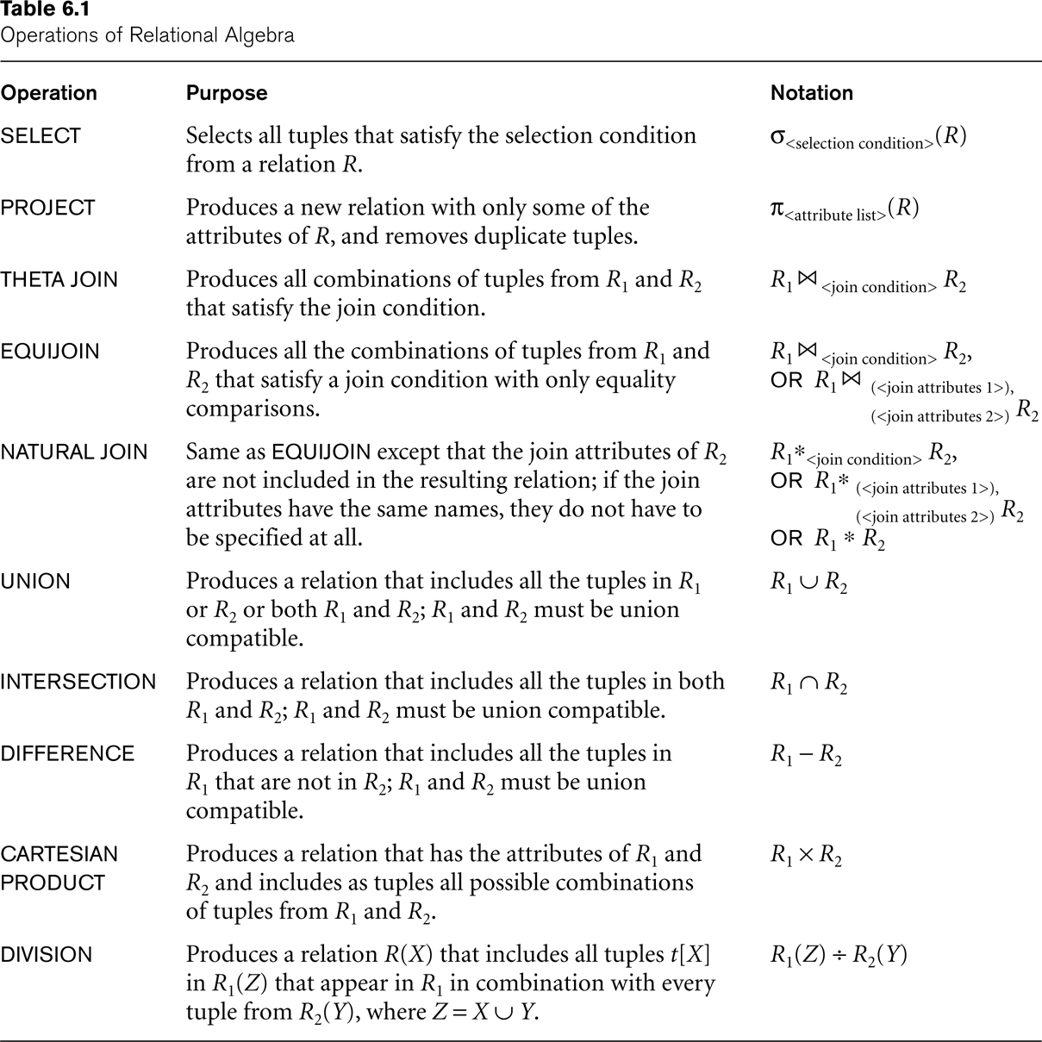
Recap of Relational Algebra Operations

Slide 63
Additional Relational Operations
Some common database requests --- which are needed in commercial applications for DBMS --- cannot be performed with the original relational algebra operations
In this section, we define additional operations to express these requests

Slide 64
Generalized Projection
It extend the projection by allowing functions of attributes to be included in the projection list.
The general form is:
π_{F1, F2, …, Fn} (R)
where F1, F2,…Fn are functions over the attributes

Slide 65
Generalized Projection
For example Consider the relation
Employee (Ssn, salary, Deduction, Year_service)
A report may be required to show:
Net_salary = salary – Deduction
Bonus = 2000 * year_service
Tax = Salary * 25%
Then a generalized projection combined with renaming may be:
Report ← ρ_{(Ssn, Net_salary, Bonus, Tax )}
(π Ssn, salary-deduction, 2000*years_service, salary*25% (R))

Slide 66
Aggregate Functions and Grouping
A type of request that cannot be expressed in the basic relational algebra is to specify mathematical aggregate functions on collections of values from the database.
Examples of such functions include retrieving the average or total salary of all employees or the total number of employee tuples.

Slide 67
Aggregate Functions and Grouping
Common functions applied to collections of numeric values include
  SUM, AVERAGE, MAXIMUM, and MINIMUM.
The COUNT function is used for counting tuples or values.

Slide 68
Aggregate Functions and Grouping
Use of the Aggregate Functional operation Ʒ
  Ʒ _{MAX Salary} (EMPLOYEE) retrieves the maximum salary value from the EMPLOYEE relation
  Ʒ _{MIN Salary} (EMPLOYEE) retrieves the minimum Salary value from the EMPLOYEE relation
  Ʒ _{SUM Salary} (EMPLOYEE) retrieves the sum of the Salary from the EMPLOYEE relation
  Ʒ _{COUNT SSN, AVERAGE Salary} (EMPLOYEE) computes the count (number) of employees and their average salary

Slide 69
Aggregate Functions and Grouping
Grouping can be combined with Aggregate Functions
Example: For each department, retrieve the DNO, COUNT SSN, and AVERAGE SALARY
A variation of aggregate operation Ʒ allows this:
  Grouping attribute placed to left of symbol
  Aggregate functions to right of symbol
  _{DNO} Ʒ _{COUNT SSN, AVERAGE Salary} (EMPLOYEE)

Slide 70
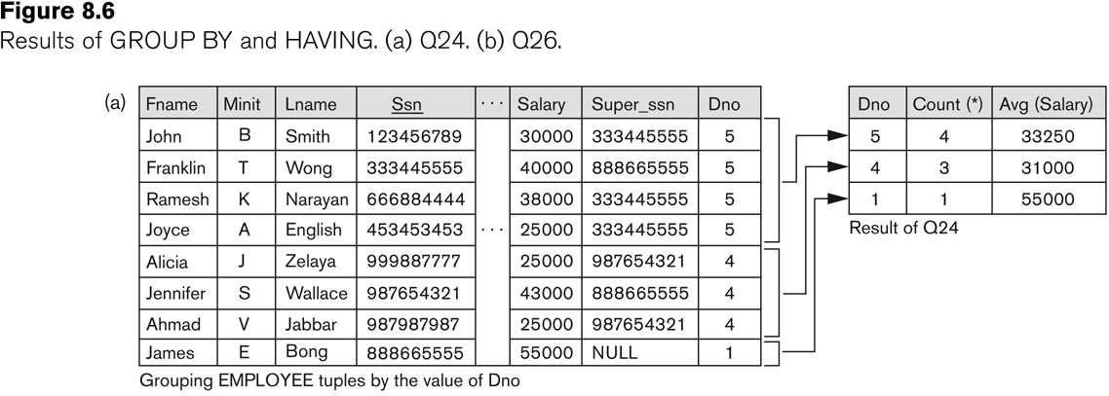
Illustrating aggregate functions and grouping

Slide 71
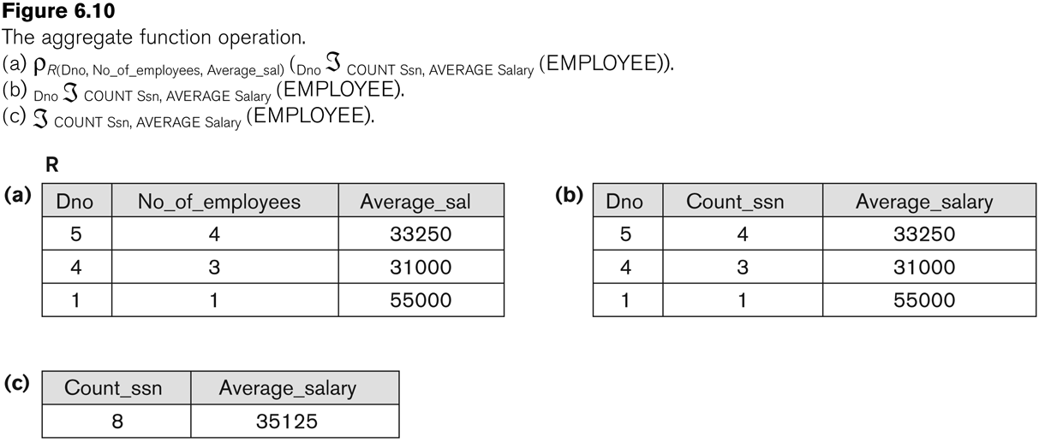
Examples of applying aggregate functions and grouping

Slide 72
Relational Algebra
Join Operators
  Outer Join Operators are Inner Join operations that only look at matching tuples from one relation to the other, attributes of tuples with no matching tuples are set to NULL
  Left Outer Join is denoted by ]X|, and keeps every tuple in the left or first relation (R)
  Right Outer Join is denoted by |X[, and keeps every tuple in the right or second relation (S)
  Full Outer Join is denoted by ]X[, and keeps all the tuples in both the left and right relations when no matching tuples are found

Slide 73
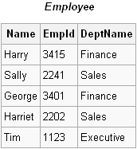
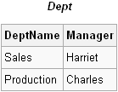
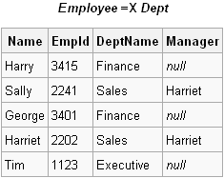
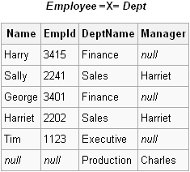
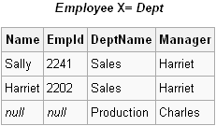
Relational Algebra
Join Operators
  Outer Join examples take two relations EMPLOYEE and DEPT
  Left Outer Join Right Outer Join Full Outer Join

Slide 74
Examples of Queries in Relational Algebra
Q5: List the names of all employees with two or more dependents

Slide 75
Examples of Queries in Relational Algebra
Q6: Retrieve the names of employees who have no dependents.

Slide 76
Examples of Queries in Relational Algebra
Q7: List the names of managers who have at least one dependent

